Slide 1
Backtracking
General Method
n-Queens Problem

Slide 2
Backtracking
General Method
The n Queens Problem
Sum Of Subsets

Slide 3
Backtracking
Suppose you have to make a series of decisions, among various choices, where
You don’t have enough information to know what to choose
Each decision leads to a new set of choices
Some sequence of choices (possibly more than one) may be a solution to your problem
Backtracking is a methodical way of trying out various sequences of decisions, until you find one that “works”

Slide 4
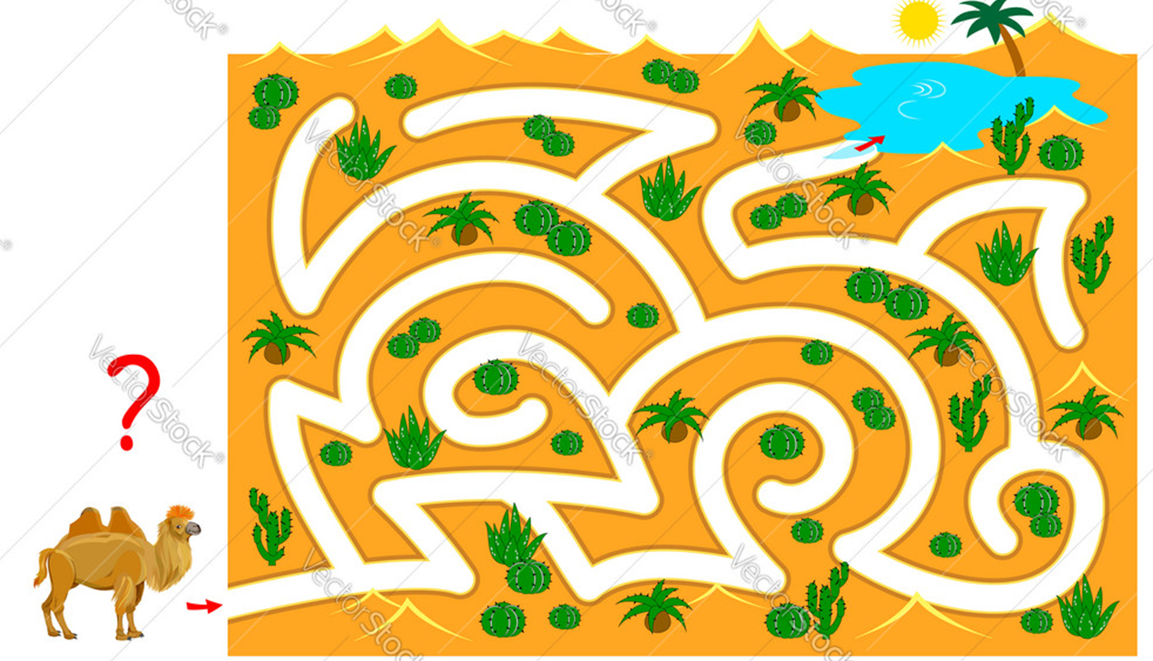

Slide 5
Solving a maze
Given a maze, find a path from start to finish
At each intersection, you have to decide between three or fewer choices:
Go straight
Go left
Go right
You don’t have enough information to choose correctly
Each choice leads to another set of choices
One or more sequences of choices may (or may not) lead to a solution
Many types of maze problem can be solved with backtracking

Slide 6

At some point in a maze, you might have two options of which direction to go:
Junction
Portion A
Portion B

Slide 7
One strategy would be to try going through Portion A of the maze.
If you get stuck before you find your way out, then you "backtrack" to the junction.
At this point in time you know that Portion A will NOT lead you out of the maze,
so you then start searching in Portion B
Junction
Portion B
Portion A

Slide 8

Clearly, at a single junction you could have even more than 2 choices.
The backtracking strategy says to try each choice, one after the other,
if you ever get stuck, "backtrack" to the junction and try the next choice.
If you try all choices and never found a way out, then there IS no solution to the maze.
Junction
C
B
A

Slide 9
Backtracking (animation)
dead end
?
dead end
dead end
?
start
?
?
dead end
dead end
?
success!

Slide 10
Terminology I
A tree is composed of nodes
There are three kinds of nodes:
The (one) root node
Backtracking can be thought of as searching a tree for a particular “goal” leaf node
Internal nodes
Leaf nodes

Slide 11
Terminology II
Each non-leaf node in a tree is a parent of one or more other nodes (its children)
Each node in the tree, other than the root, has exactly one parent
parent
Usually, however, we draw our trees downward, with the root at the top
parent
children
children

Slide 12
Backtracking -General Method
The name backtrack was first coined by D.H Lehmer in 1950s
One of the most general techniques for algorithm design
It can be used for problems that have a set of solutions
The desired solution is expressible as an n-tuple(x1,x2…xn) where xi are chosen from some finite set si.
Find one vector that maximizes(or minimizes) a criterion function P(x1,x2,……xn) of integers in a[1…n] where xi is the index in a of the i th smallest element

Slide 13
The backtracking algorithm
Backtracking is really quite simple--we “explore” each node, as follows:
To “explore” node N:
1. If N is a goal node, return “success”
2. If N is a leaf node, return “failure”
3. For each child C of N,
3.1. Explore C
3.1.1. If C was successful, return “success”
4. Return “failure”

Slide 14
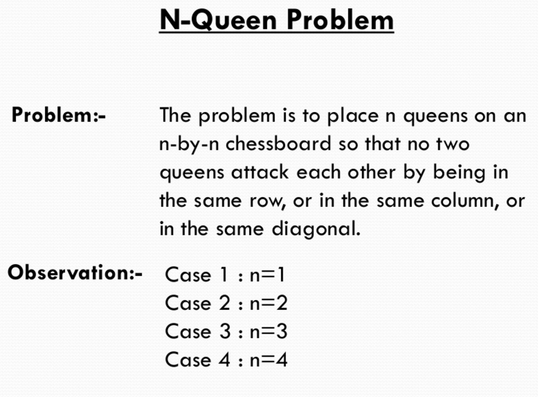
Backtracking

Slide 15
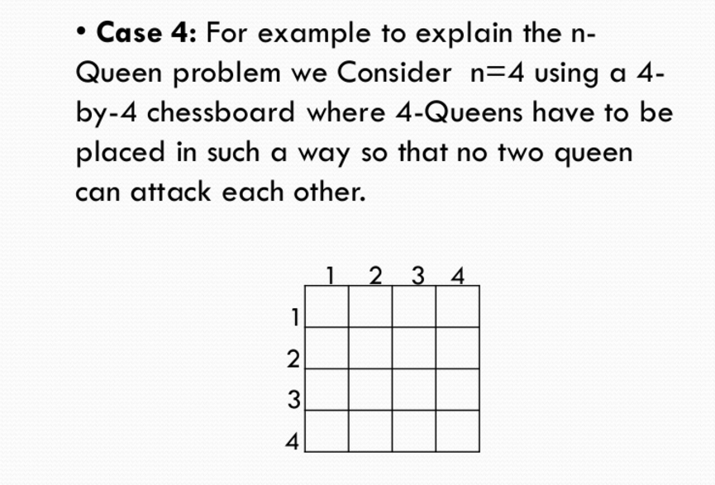
Backtracking

Slide 16
Q
Q
Q
Q
Q
Q
Q
Q
Q
Q
Q
Q
Q
Q
Q

Slide 18
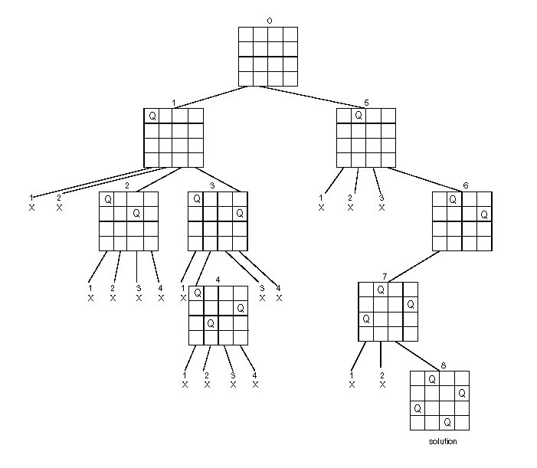
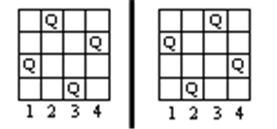
Backtracking – Four Queens Problem
State Space Tree of the Four-queens Problem
Place n queens on an 4 by 4 chess board so that no two of them are on the same row, column, or diagonal
Two Solutions:
When we carry out backtracking, an easy way to visualize what is going on is a tree that shows all the different possibilities that have been tried.

Slide 20
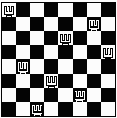
Backtracking – Eight Queens Problem
Find an arrangement of 8 queens on a single chess board such that no two queens are attacking one another.
In chess, queens can move all the way down any row, column or diagonal (so long as no pieces are in the way).
Due to the first two restrictions, it's clear that each row and column of the board will have exactly one queen.

Slide 21
The 8 Queen’s Problem
Problem Definition
Place eight queens on a 8*8 chessboard so that no two of them are on the same row, column or diagonal
Constraints
No two x_{i} can be the same
Each queen must be on a different row
No two queens can be on the same diagonal
The solution space consists of 8^8 tuples

Slide 22

Backtracking – Eight Queens Problem
The backtracking strategy is as follows:
Place a queen on the first available square in row 1.
Move onto the next row, placing a queen on the first available square there (that doesn't conflict with the previously placed queens).
Continue in this fashion until either:
you have solved the problem, or
you get stuck.
When you get stuck, remove the queens that got you there, until you get to a row where there is another valid square to try.
Q
Q
Q
Q
Q
Q
Continue…

Slide 23
The 8 Queen’s Problem-Example
 | 1 | 2 | 3 | 4 | 5 | 6 | 7 | 8
1 |  | Q
2 |  |  |  | Q
3 |  |  |  |  |  | Q
4 |  |  |  |  |  |  |  | Q
5 |  |  | Q
6 | Q
7 |  |  |  |  |  |  | Q
8 |  |  |  |  | Q

Slide 24
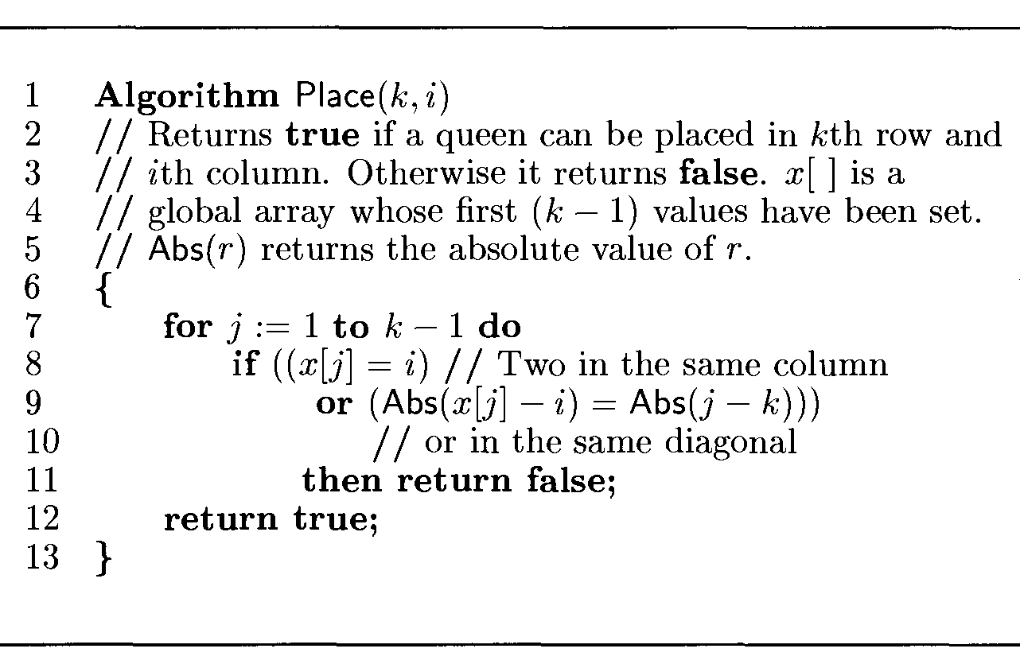
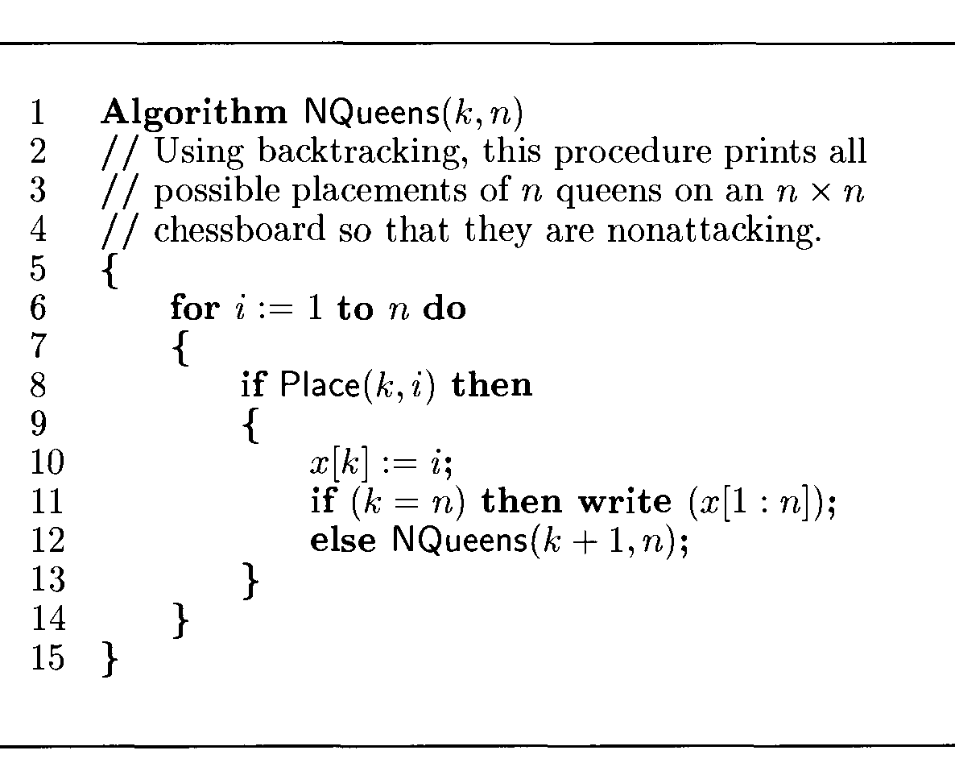
The n Queen’s Problem-Algorithm

